Slide 1
Introduction to Redux ToolKit

Slide 2
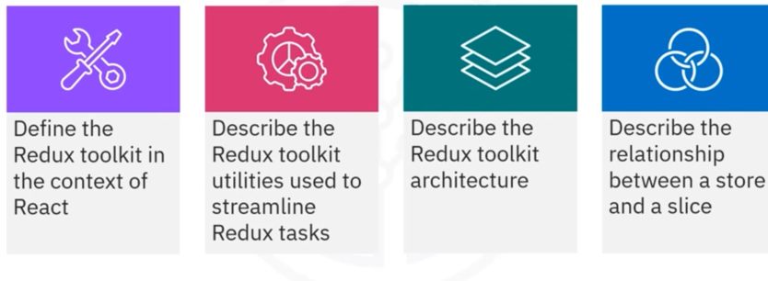
What you will learn

Slide 3
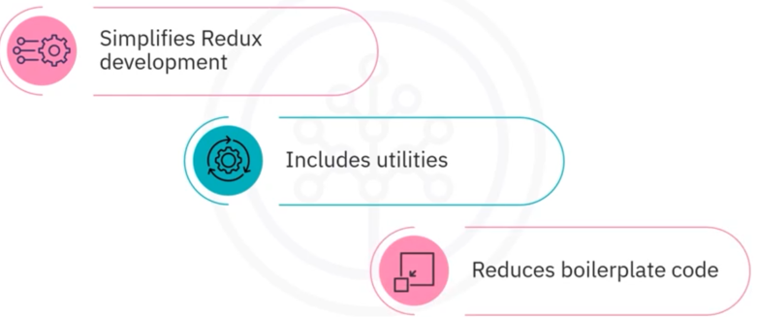
Introduction to Redux toolkit

Slide 4
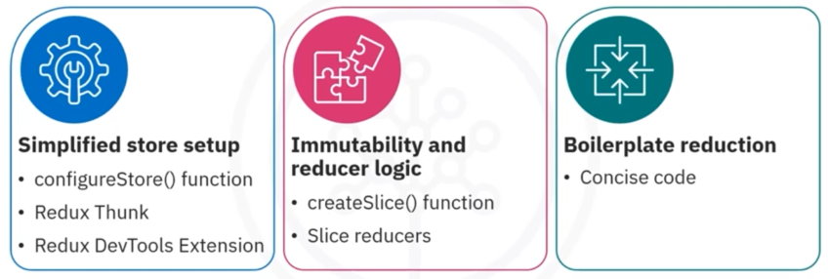
Redux toolkit utilities

Slide 5
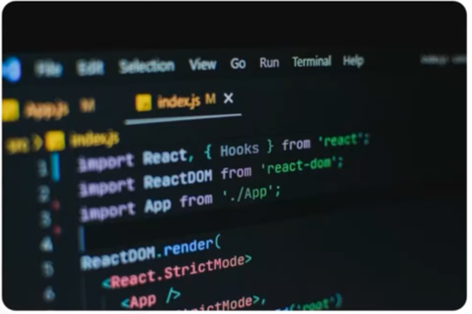

Installing RTK

Slide 6
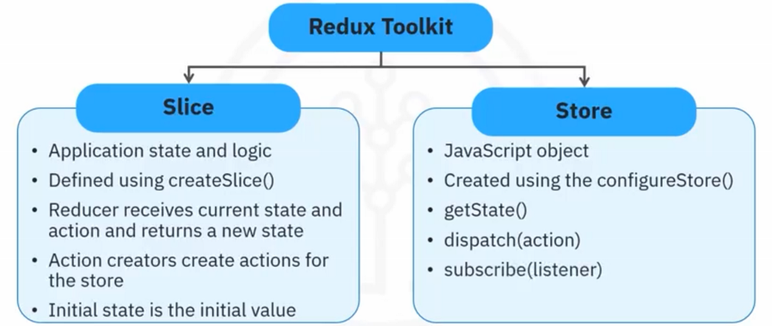
Redux toolkit architecture

Slide 7
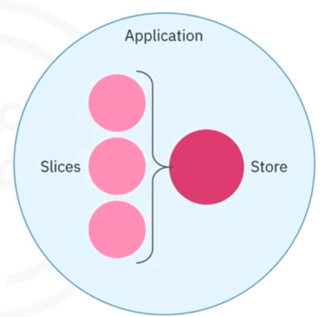
Slices and store relationship
Relationship Application
• Slices define parts of the
application state and logic to
update them
• Store combines slices to form
application state tree

Slide 8
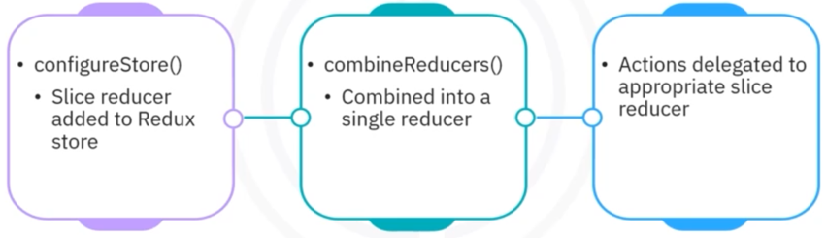
Slices and store relationship

Slide 9
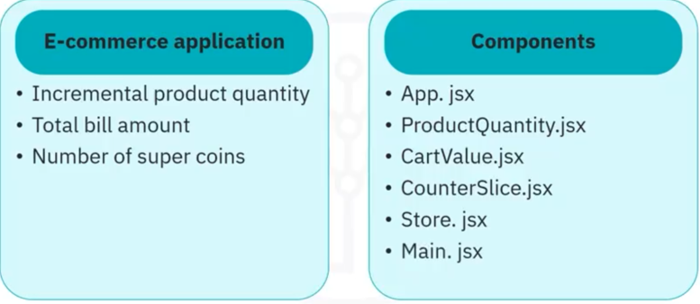
Slices and store relationship example

Slide 10
Recap
In this video, you learned that:
• In the context of React, the Redux toolkit (RTK) is an official package, the Redux
team provides, to simplify Redux development and make it more efficient
• Redux toolkit provides a configureStore() function that combines several pieces of
Redux setup logic into a single function call
• Redux toolkit introduces the createSlice() function, which allows developers to
define "slice reducers" that automatically handle immutable updates to the state
• A slice in the Redux toolkit represents a piece of your application state and the
logic to update it
• The Redux store is a single JavaScript object that holds the complete state tree of
your application

